Slide 1
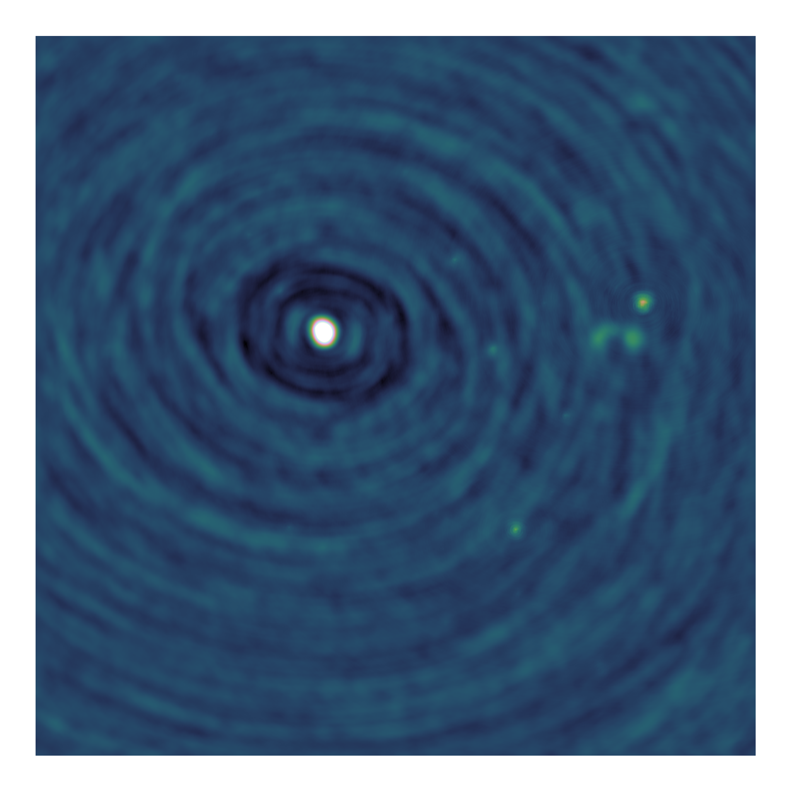
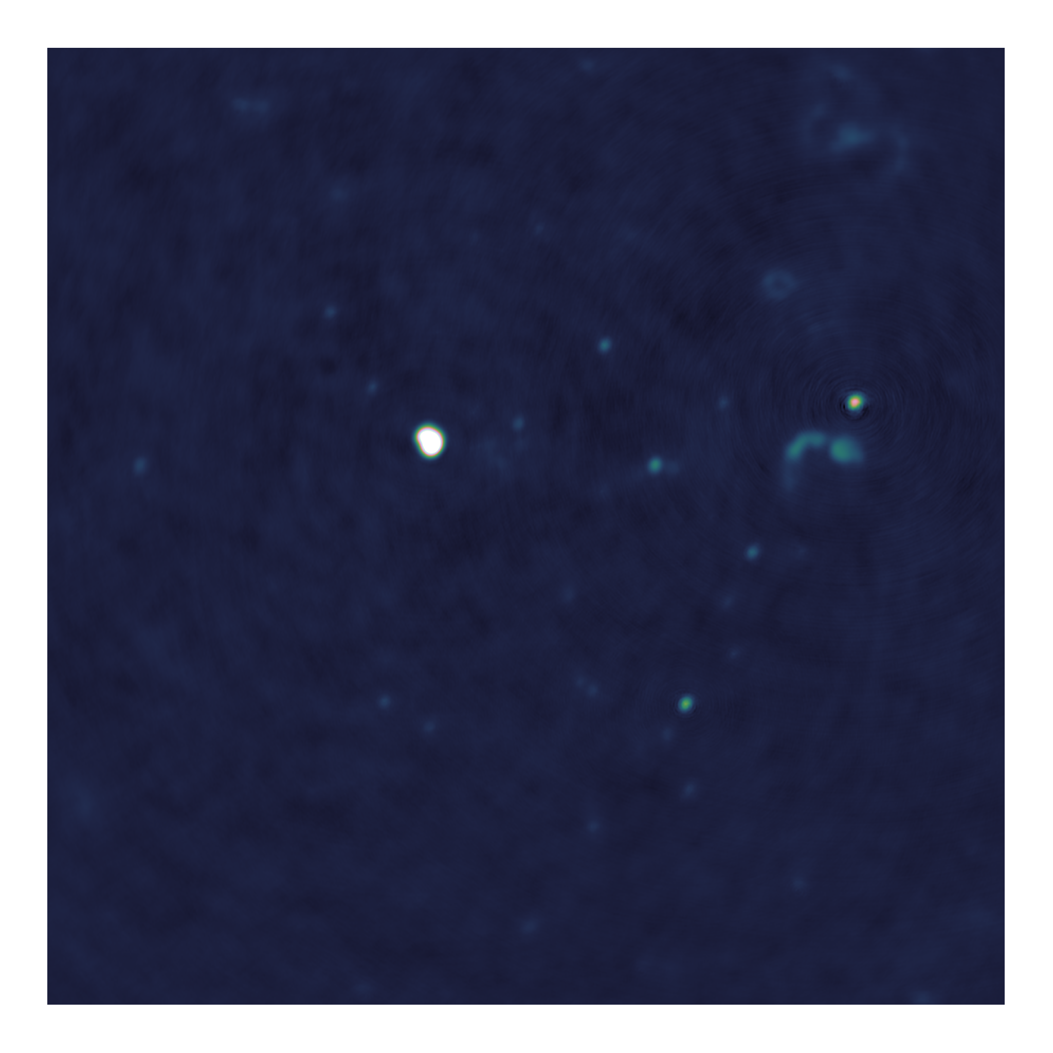
Towards distributed image reconstruction for radio interferometers

Slide 2
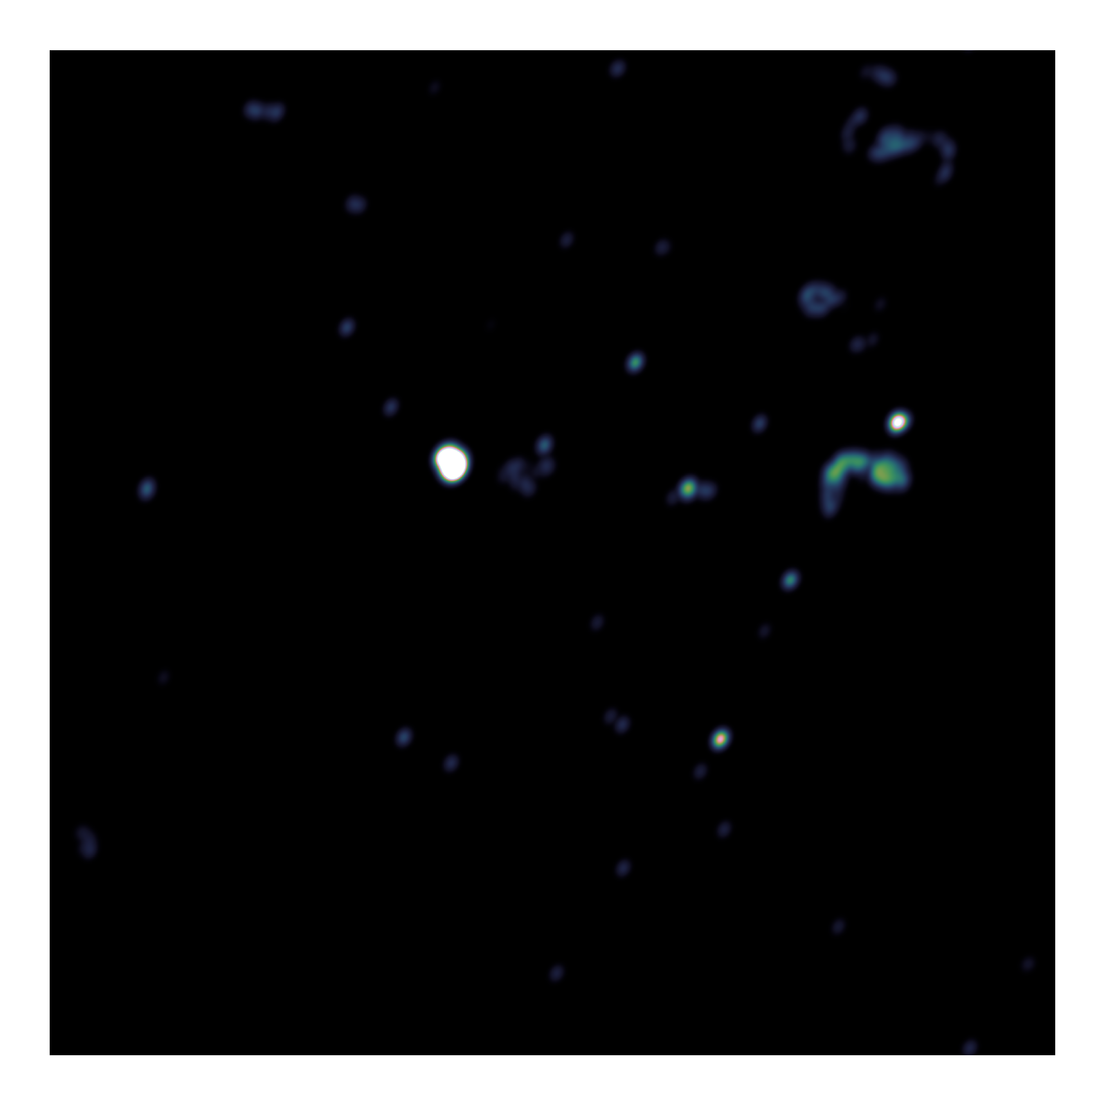
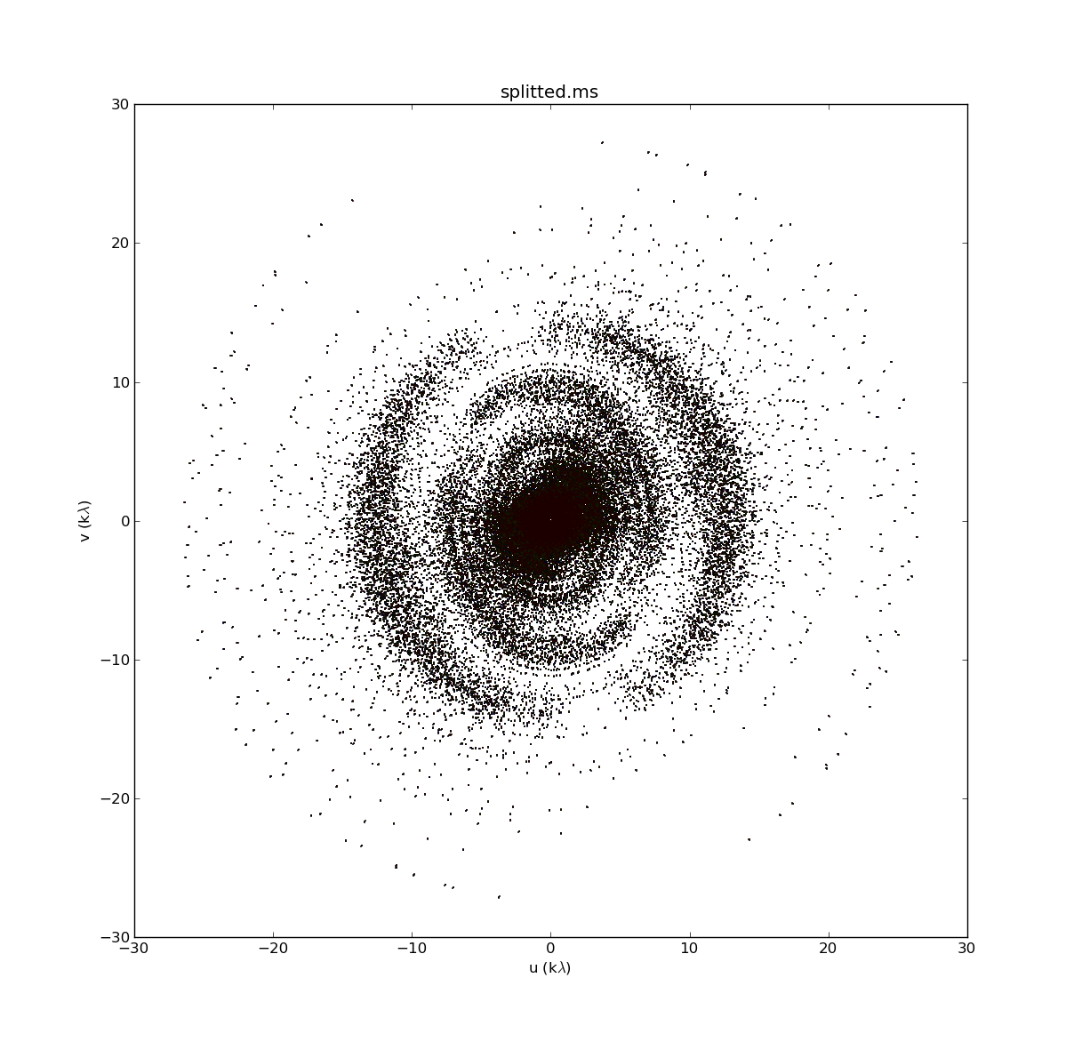
Image reconstruction problem
Fourier Measurements
Dirty Image
Model Image
Fourier Transform
Deconvolution

Slide 3
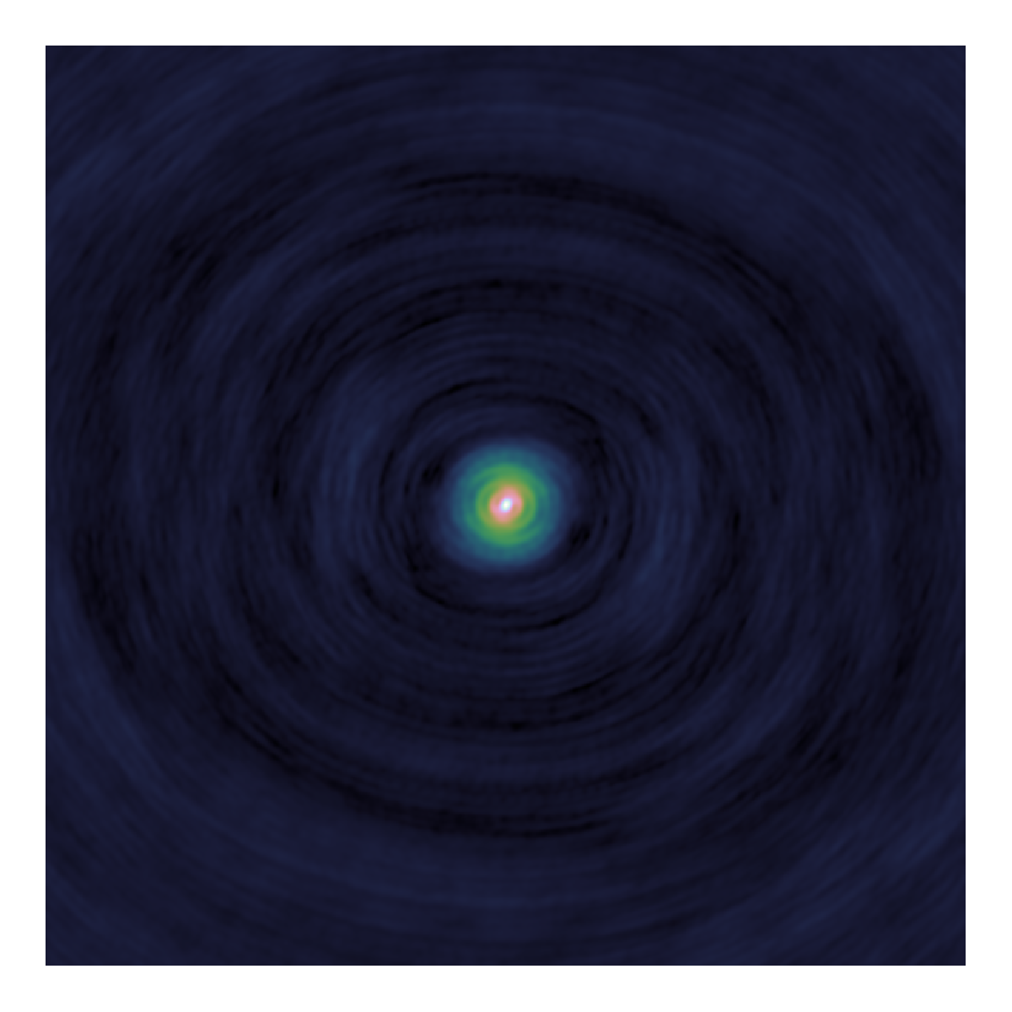
Deconvolution
Dirty
Image
Model
Image
PSF

Slide 4
Major/Minor Cycle
Fourier Transform
Deconvolution(Minor cycle)
Dirty
Image
Model
Fourier C.
Residual
Fourier C.
Model
Image
PSF
Fourier Transform

Slide 5
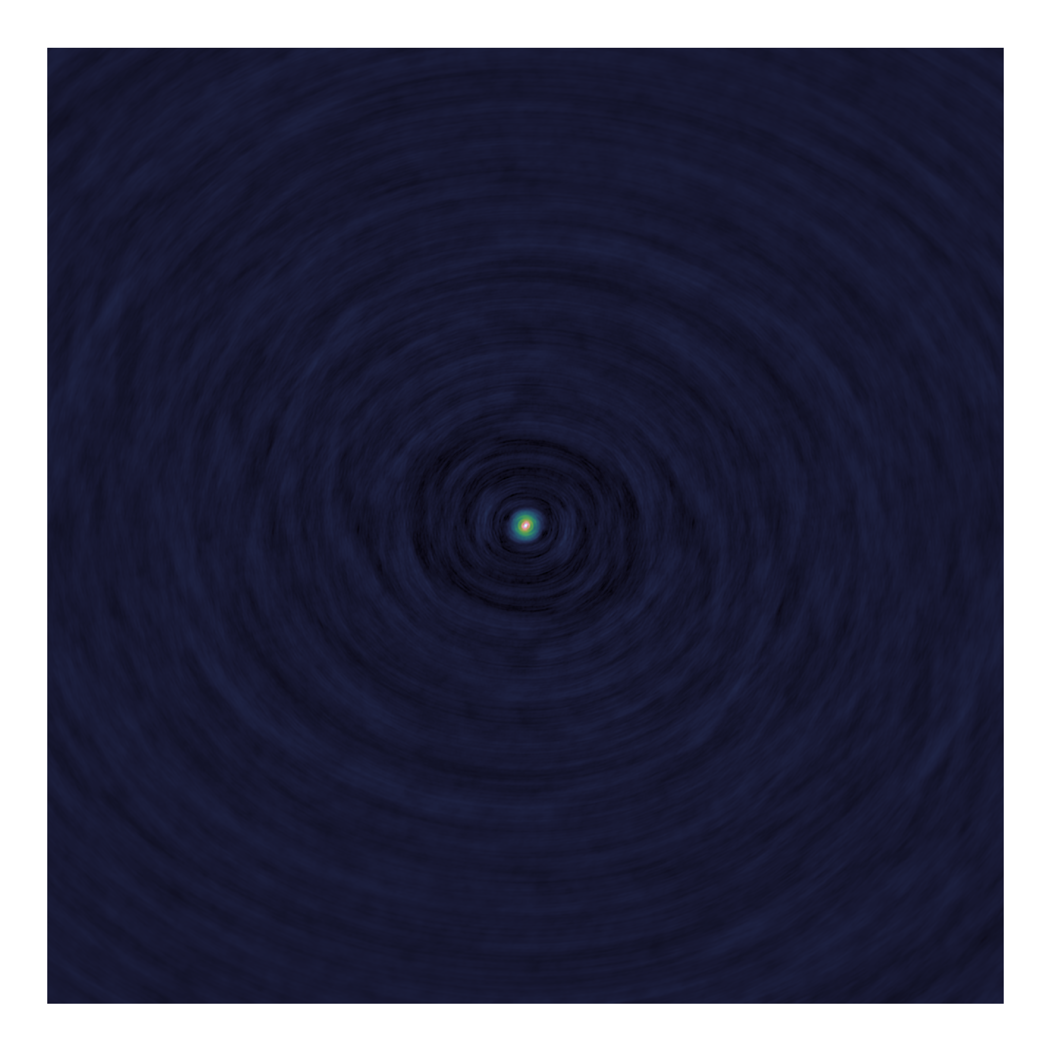
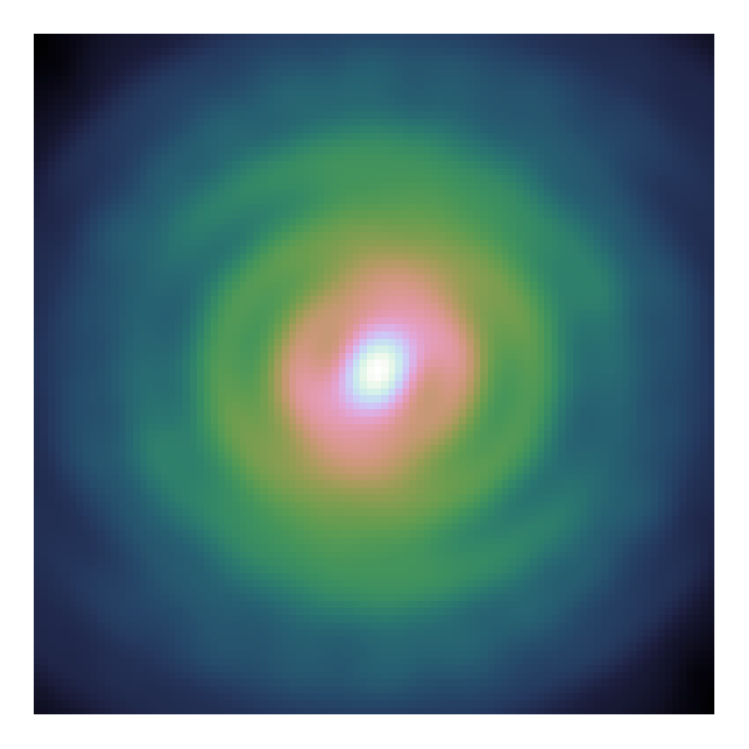
PSF Approximation?

Slide 6
Deconvolution algorithms
Serial Coordinate Descent
Simple
Slow
Parallel Coordinate Decent
Fast
Easy to distribute

Slide 7
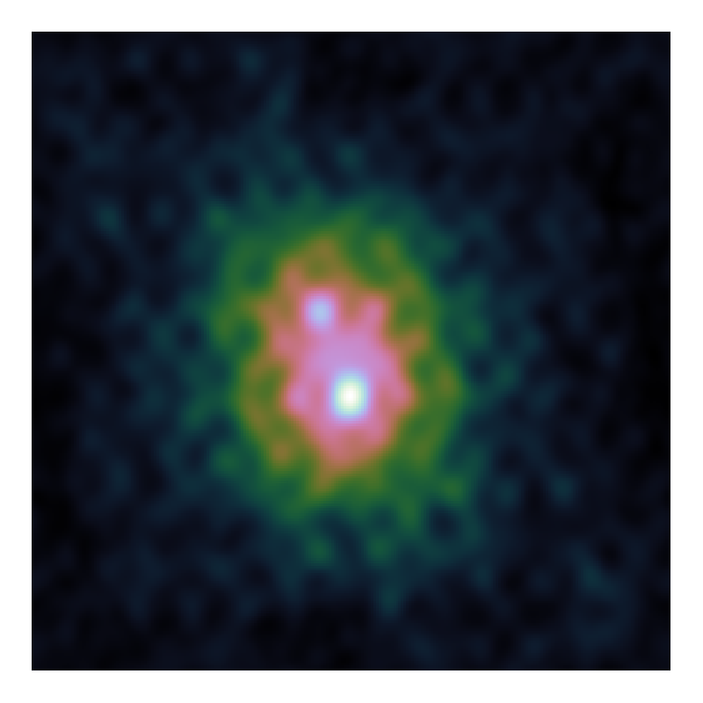
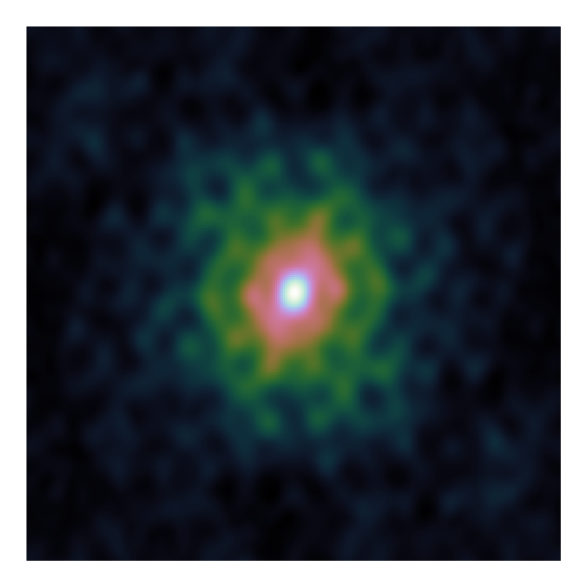
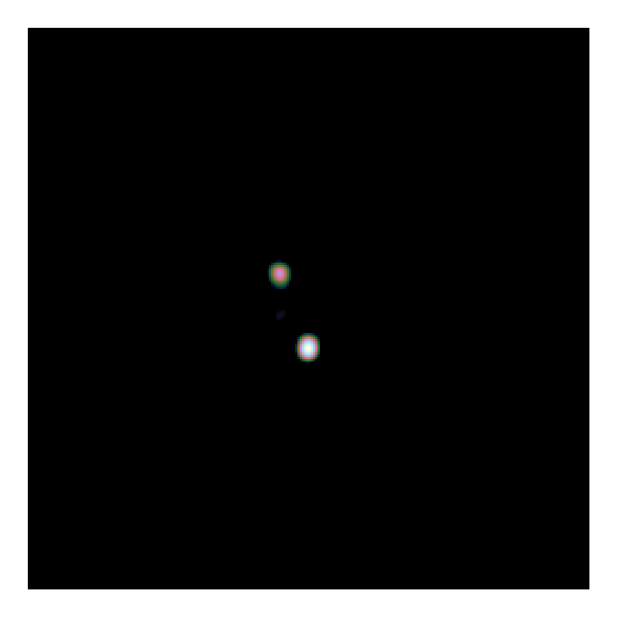
Simulated deconvolution problem
Dirty Image
PSF
Model Image

Slide 8
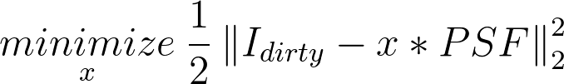
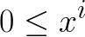
Convex Objective
Deconvolution

Slide 9
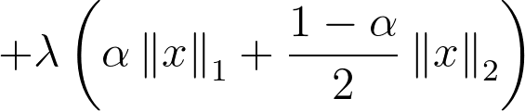
Convex Objective
Deconvolution
Elastic Net Regularization
Model image contains stars…
…But also
clouds of gas/dust

Slide 10
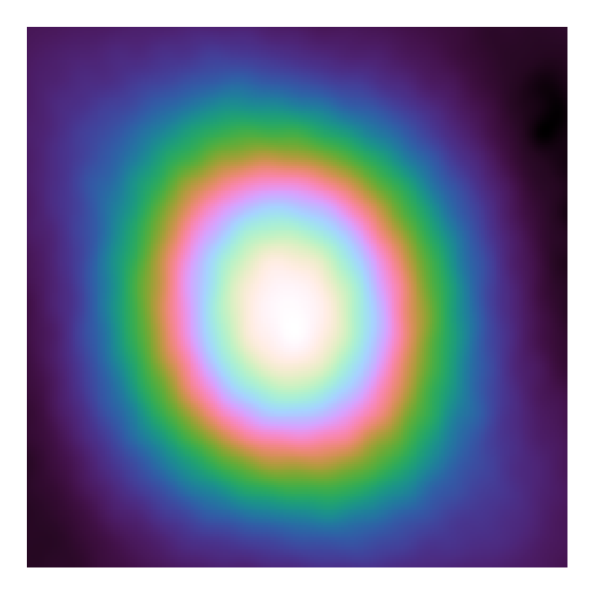

Serial Coordinate Descent
Dirty Image
Gradient Map
Model Image

Slide 11
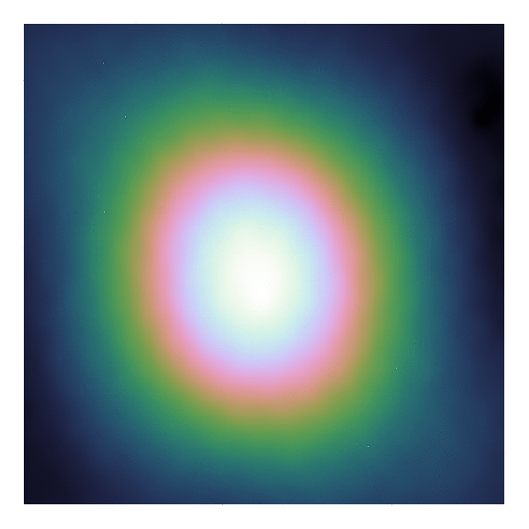

Serial Coordinate Descent
Gradient Map
Model Image

Slide 12
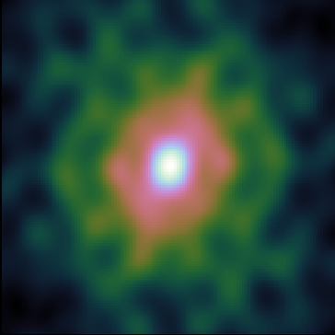


Serial CD with approx. PSF
$$⋆$$
=
$$⋆$$
=

Slide 13
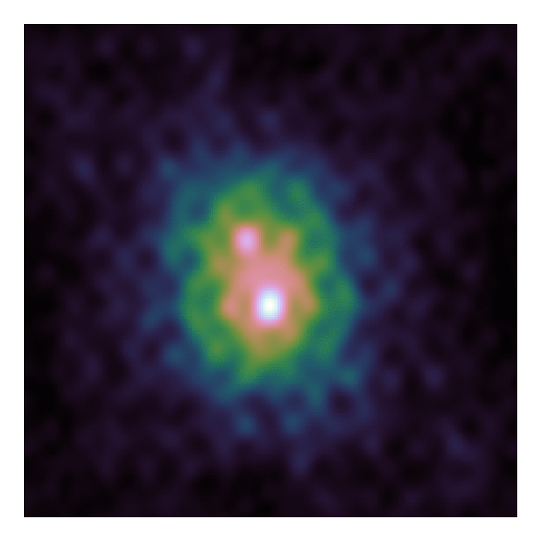

CLEAN
Dirty Image
Model Image

Slide 14

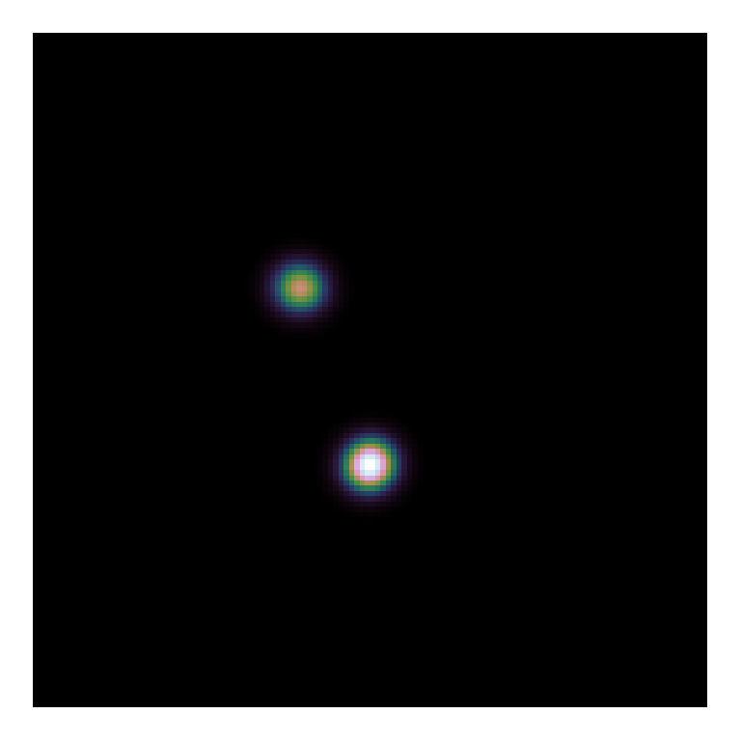
CLEAN
Model Image
Restored Image

Slide 15
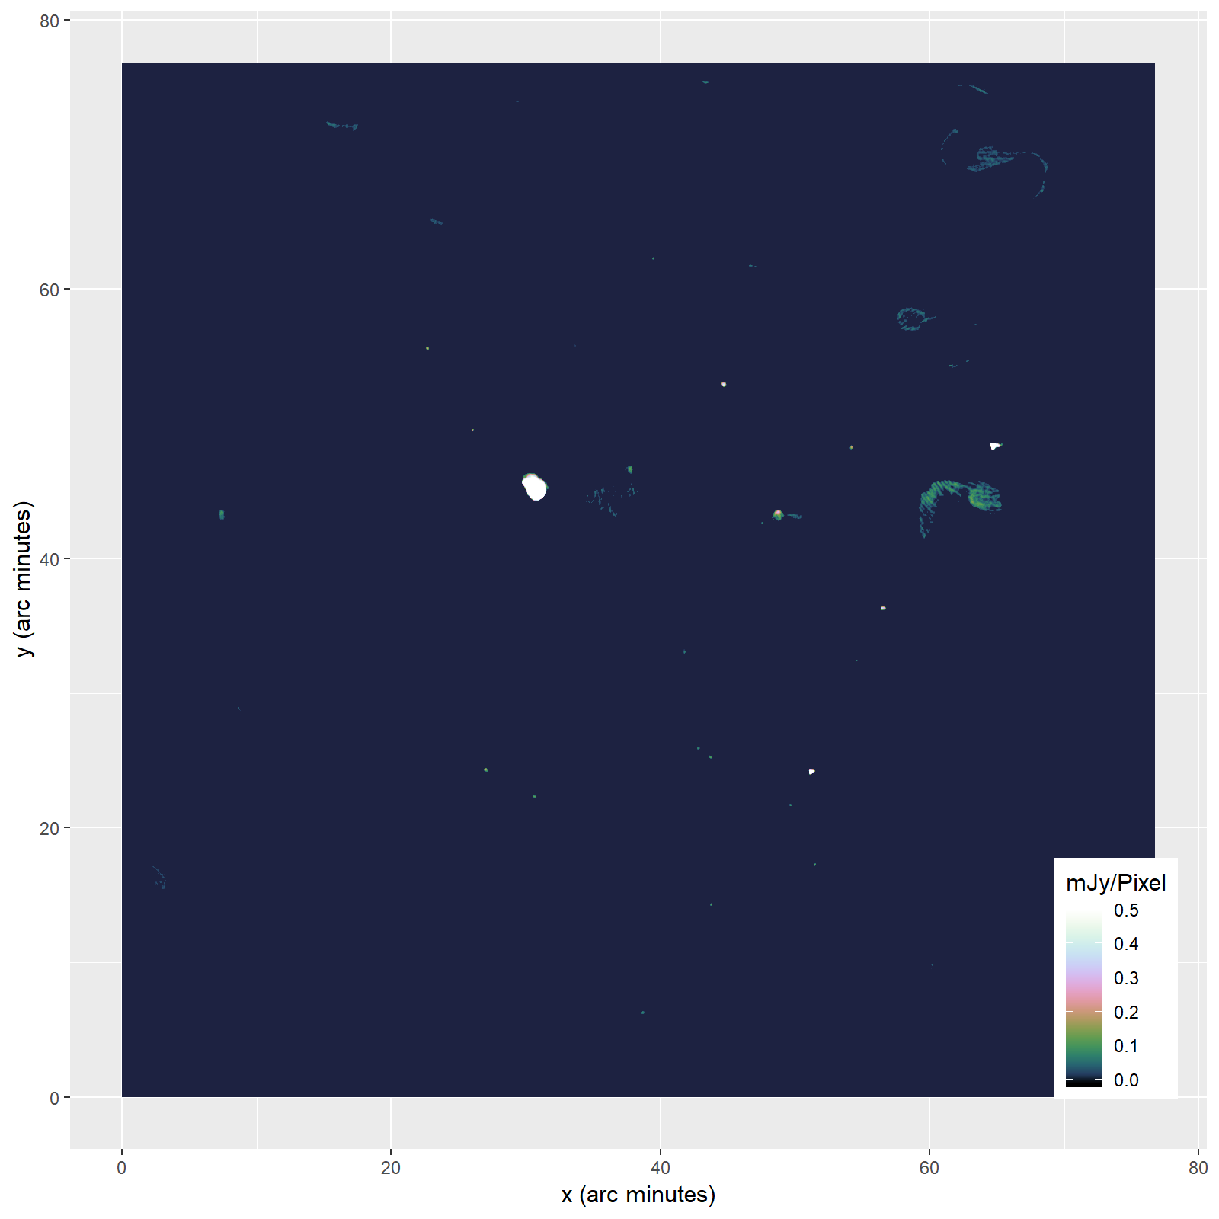

Slide 16
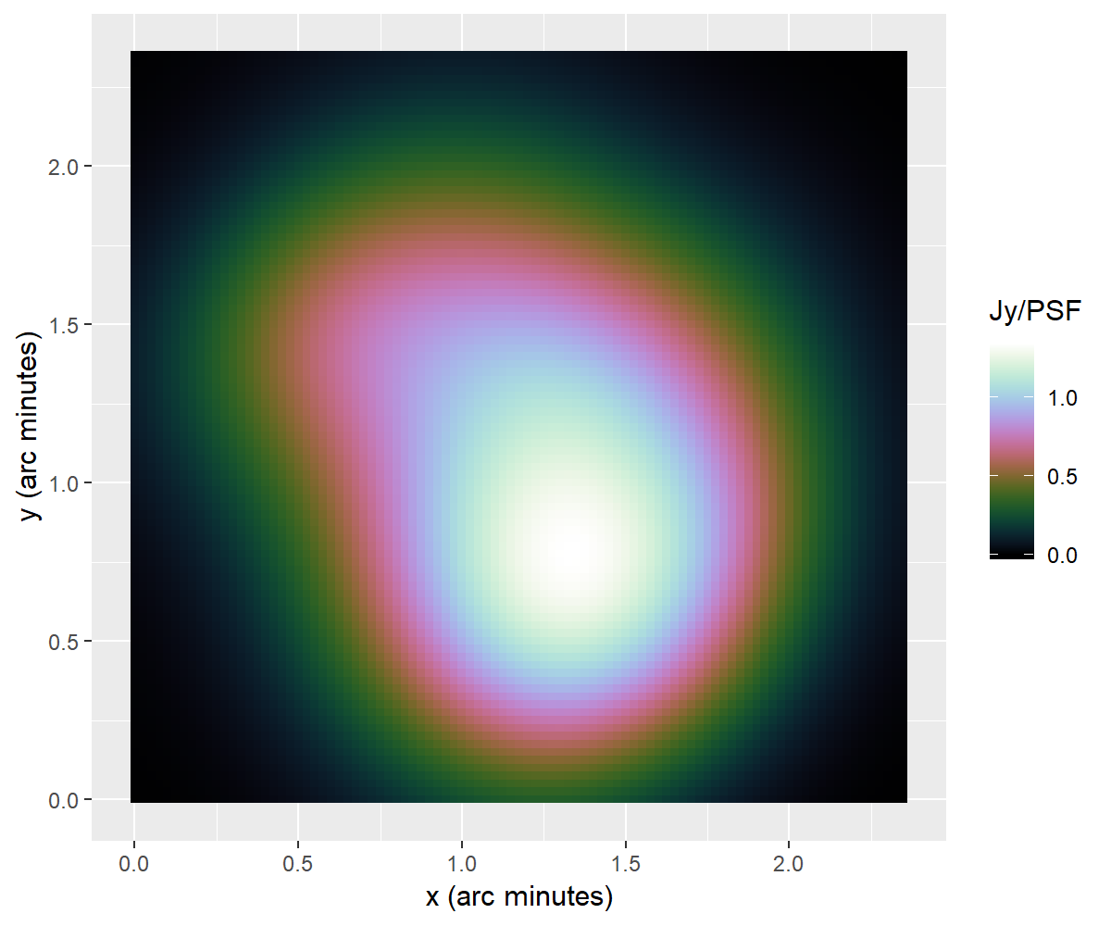
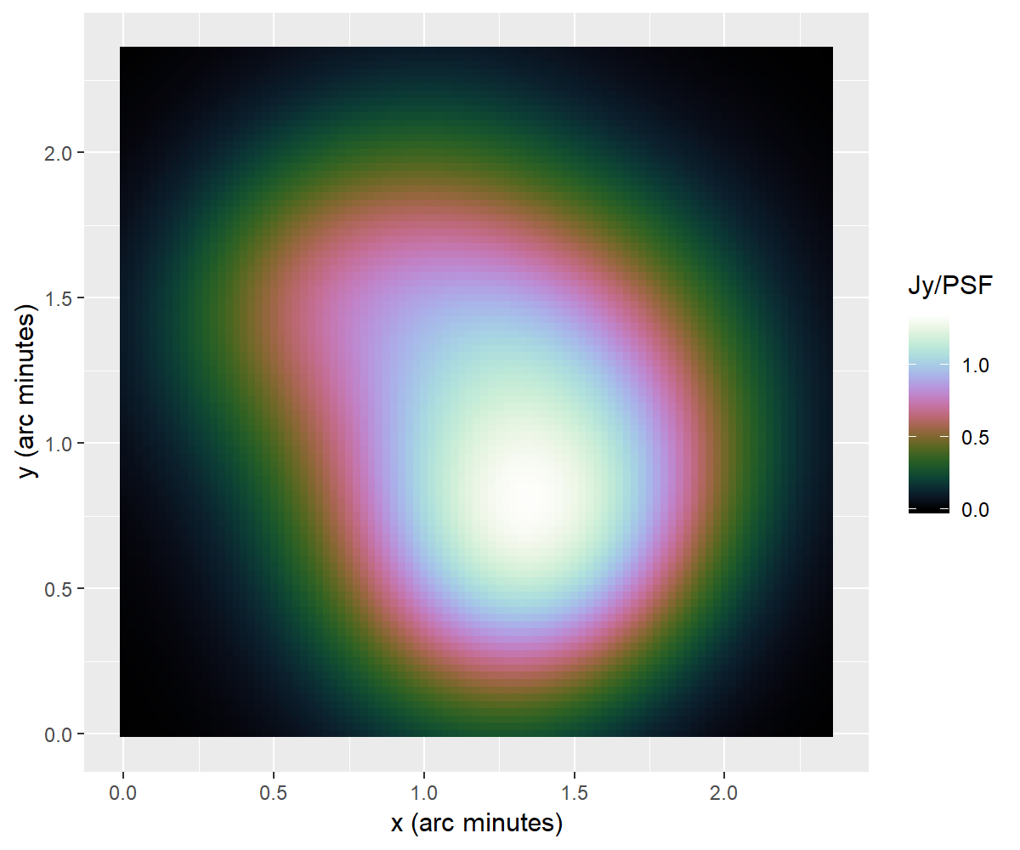
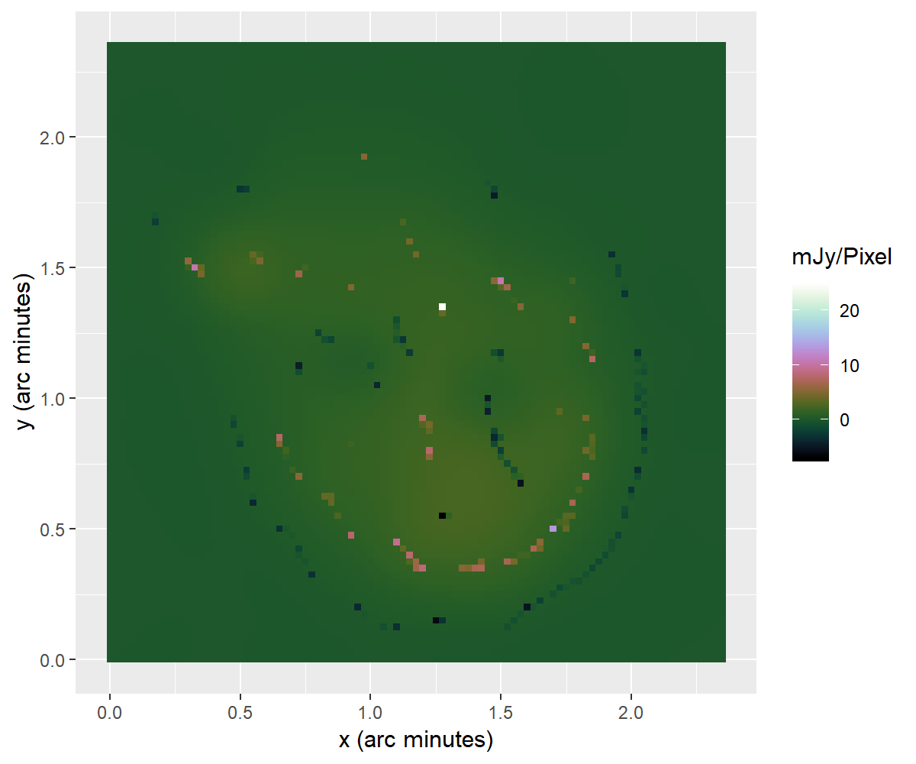
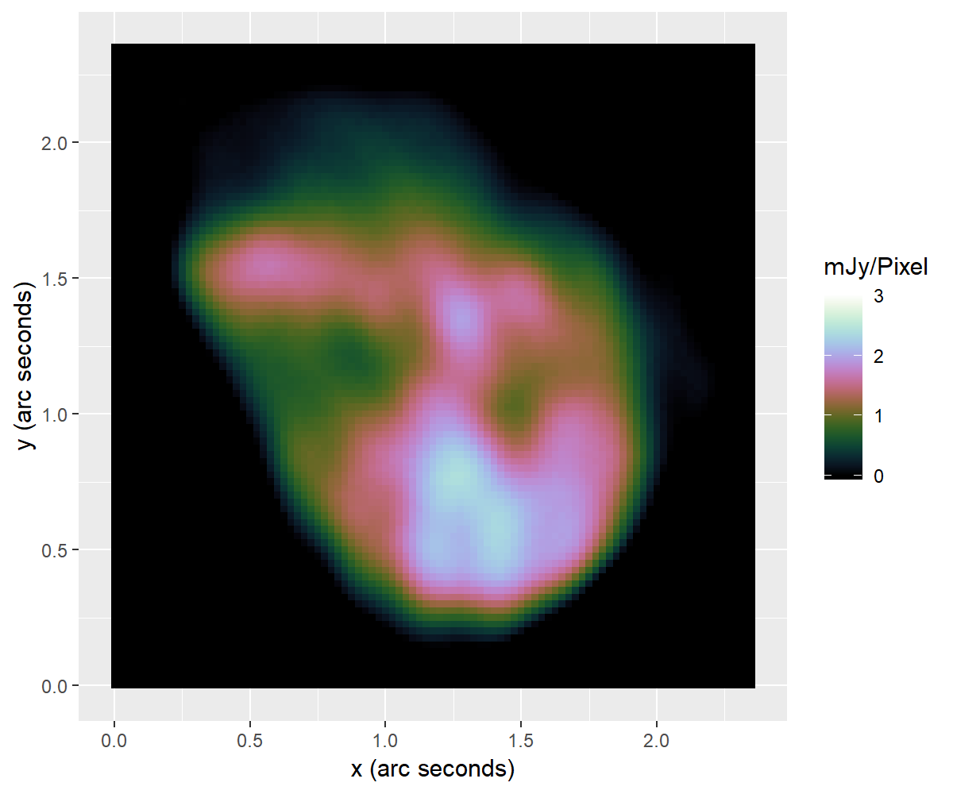
MS-CLEAN
Coordinate Descent

Slide 17
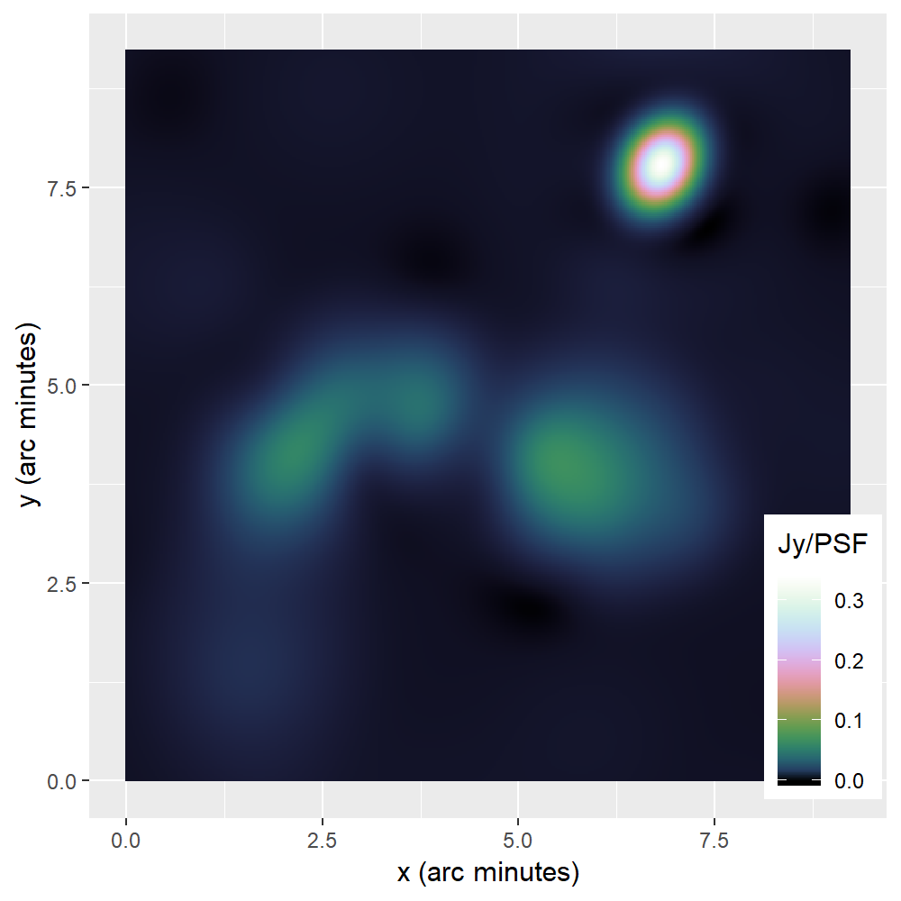
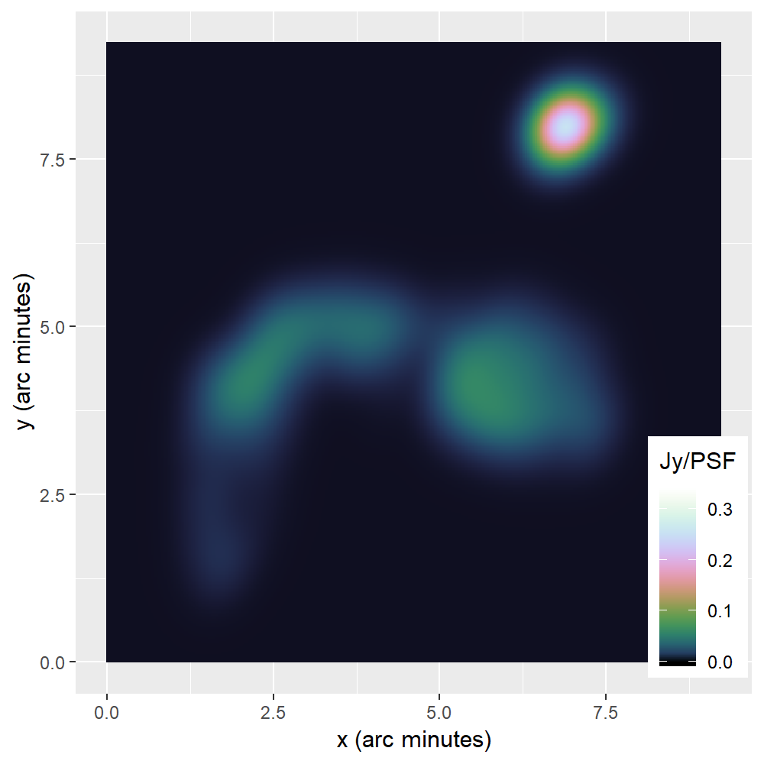
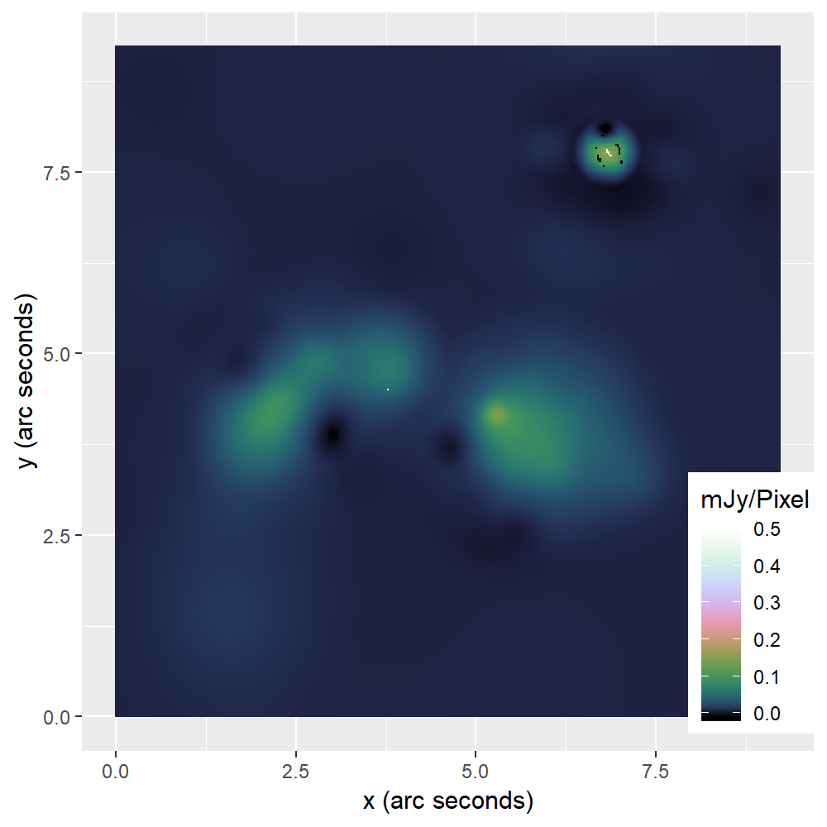
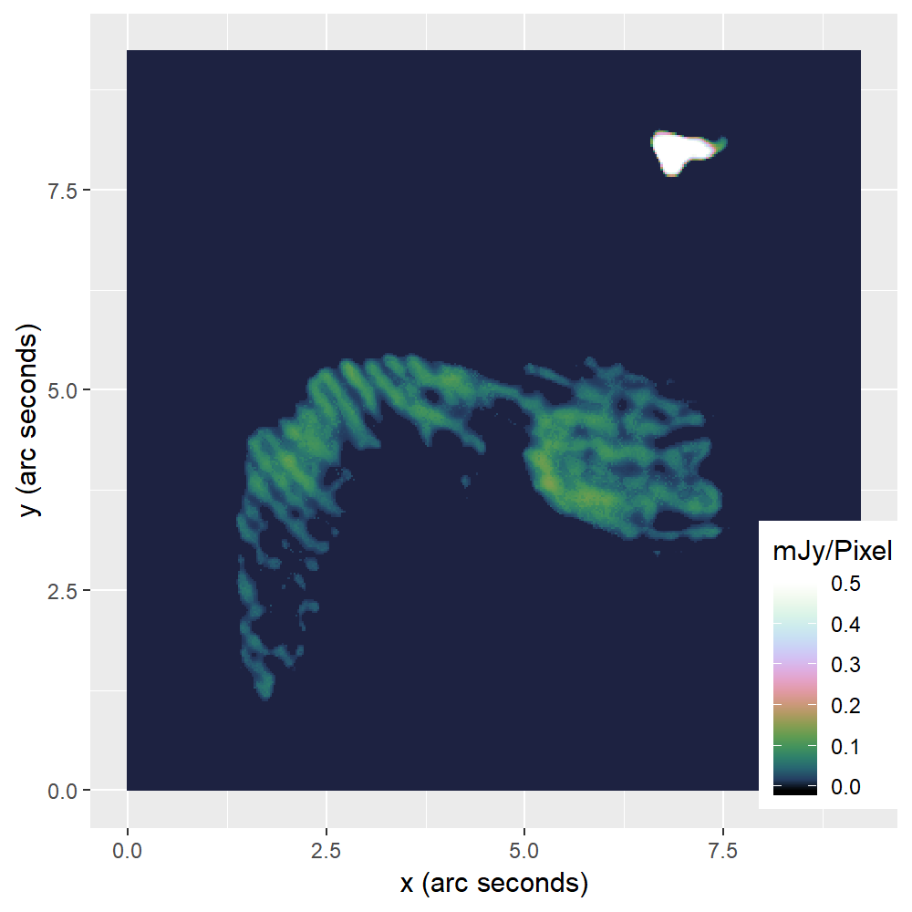
MS-CLEAN
Coordinate Descent

Slide 18
Serial CD VS MS-CLEAN
MS-CLEAN: 15’000 iterations
Serial CD: 100’000 iterations
PSF Approx. speedup: 1.6
GPU acceleration speedup: 2

Slide 19
Parallel deconvolution

Slide 20
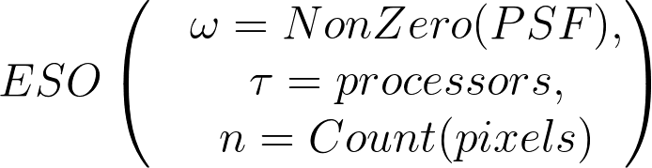
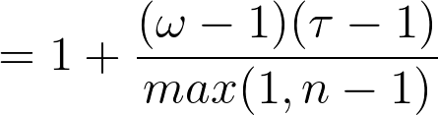
Estimated Separability Over-approximation (ESO)

Slide 21

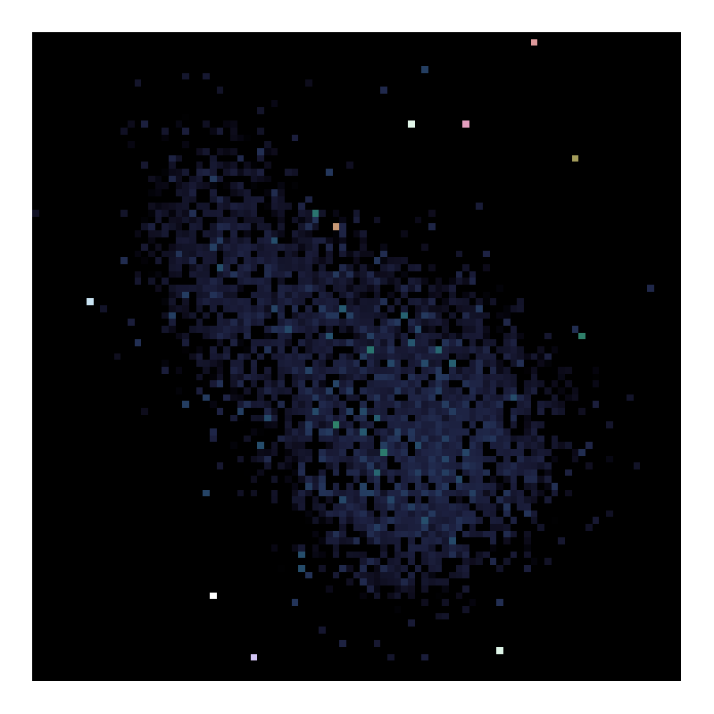
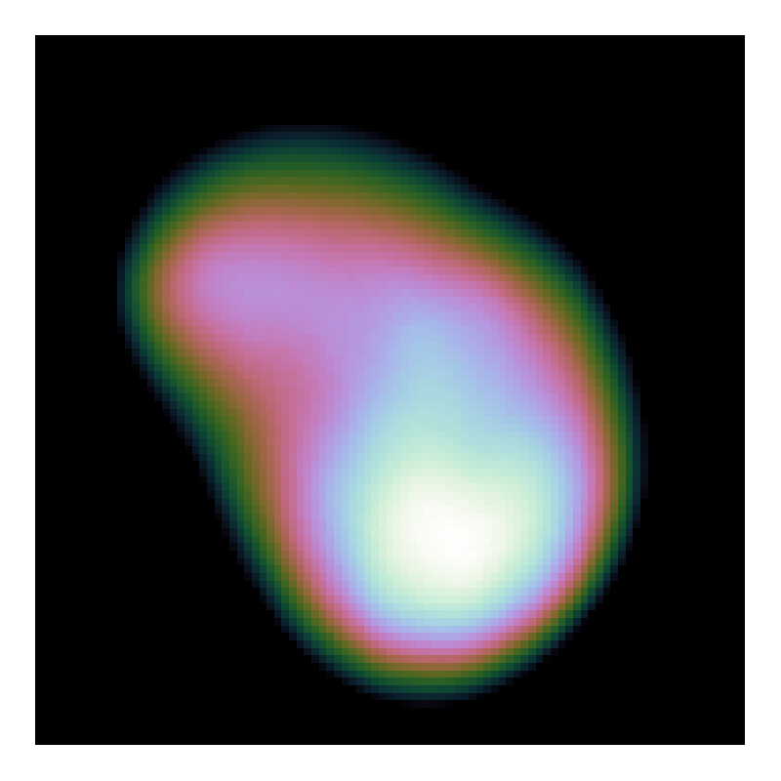
Random Selection Strategy
8k iterations
80k iterations
50k iterations
Random Pixel Selection
Pseudo-Random Selection

Slide 22
Parallel CD
Pseudo-Random Selection Strategy
Asynchronous implementation
ESO benefits from PSF approximation

Slide 23
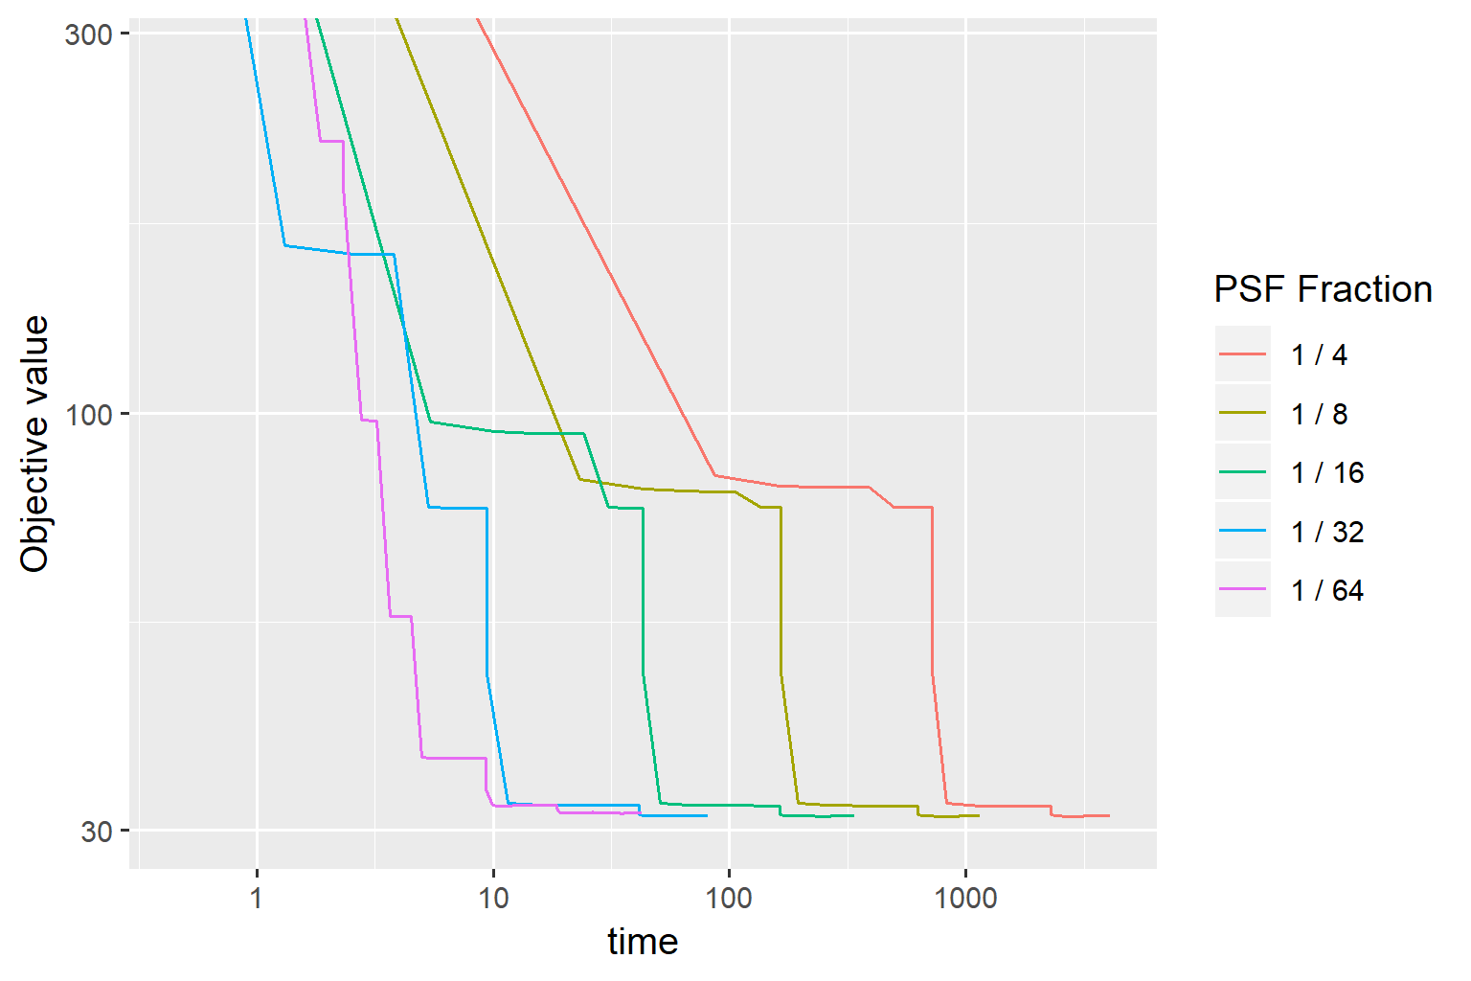
Speedup PSF Approximation

Slide 24
Speedup
Parallel Coordinate Descent:
20x faster than Serial CD
≈3x faster than MS-CLEAN

Slide 25
Scalability

Slide 26
Limitations
Tested on a single observation
Compare to MS-CLEAN in the Wideband + Full-Polarization setting

Slide 27
?

Slide 31
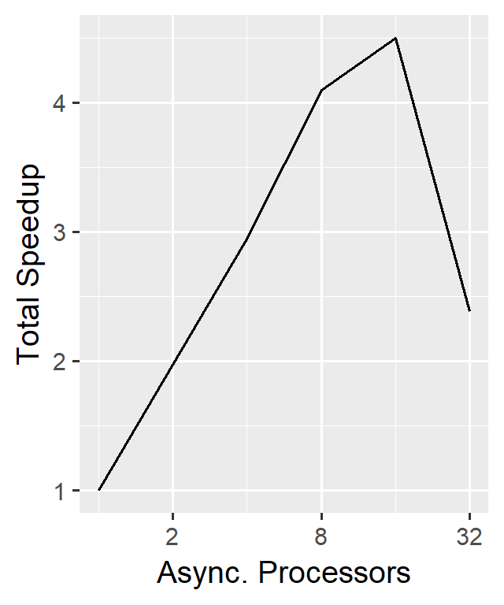
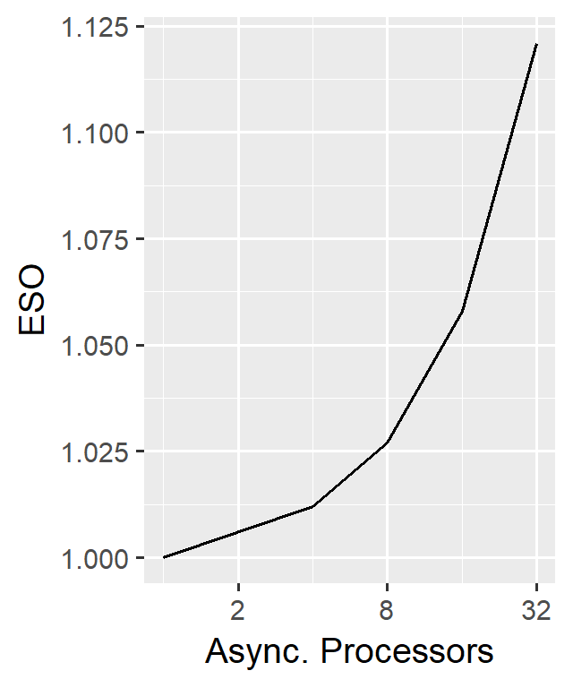
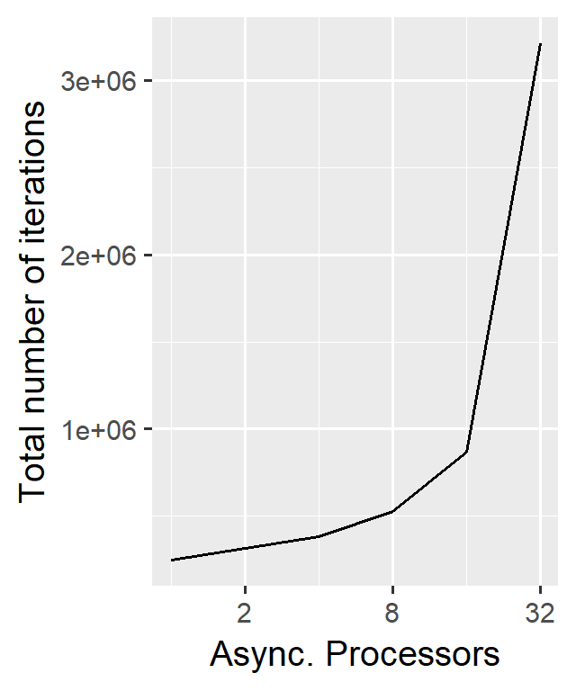
Scalability

Slide 32
Test
Table

Slide 33
MS-CLEAN
Coordinate Descent

Slide 34
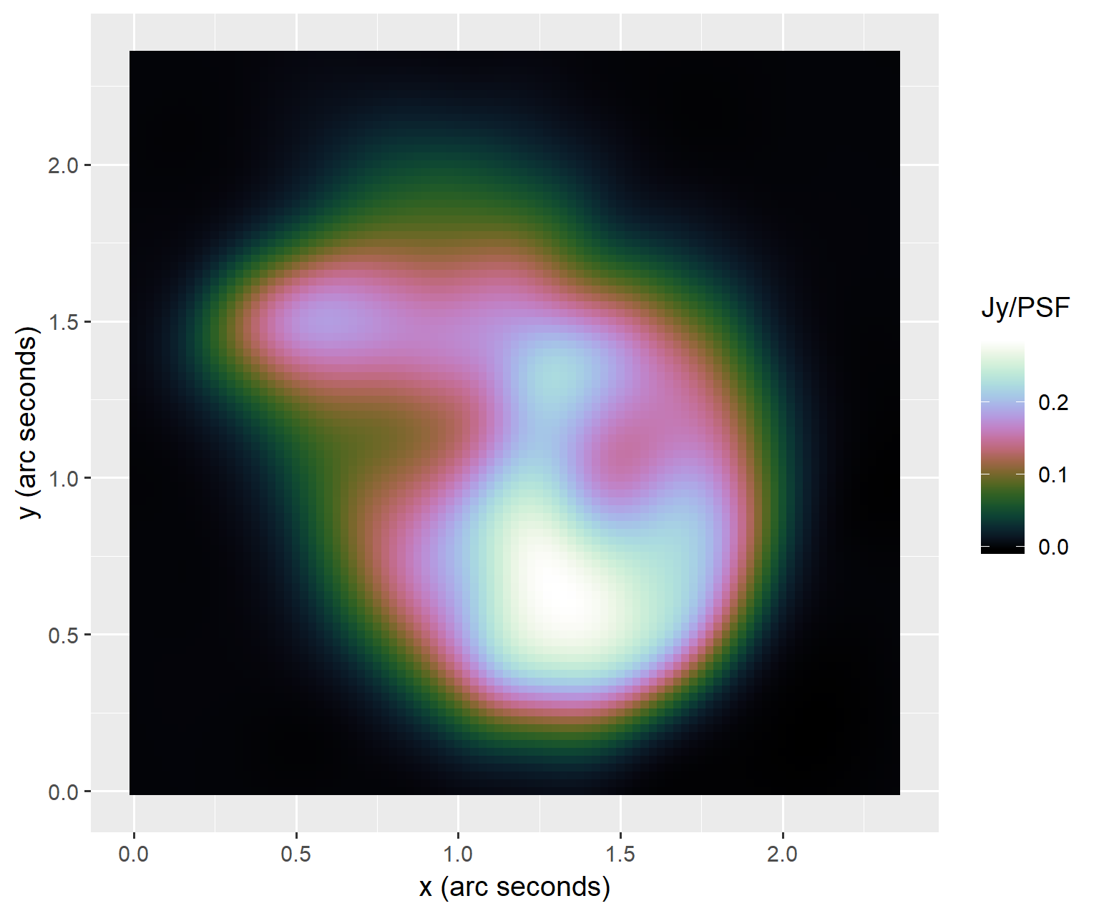
MS-CLEAN
Coordinate Descent
MS-CLEAN Briggs restored

Slide 35
MS-CLEAN
Coordinate Descent

Slide 36
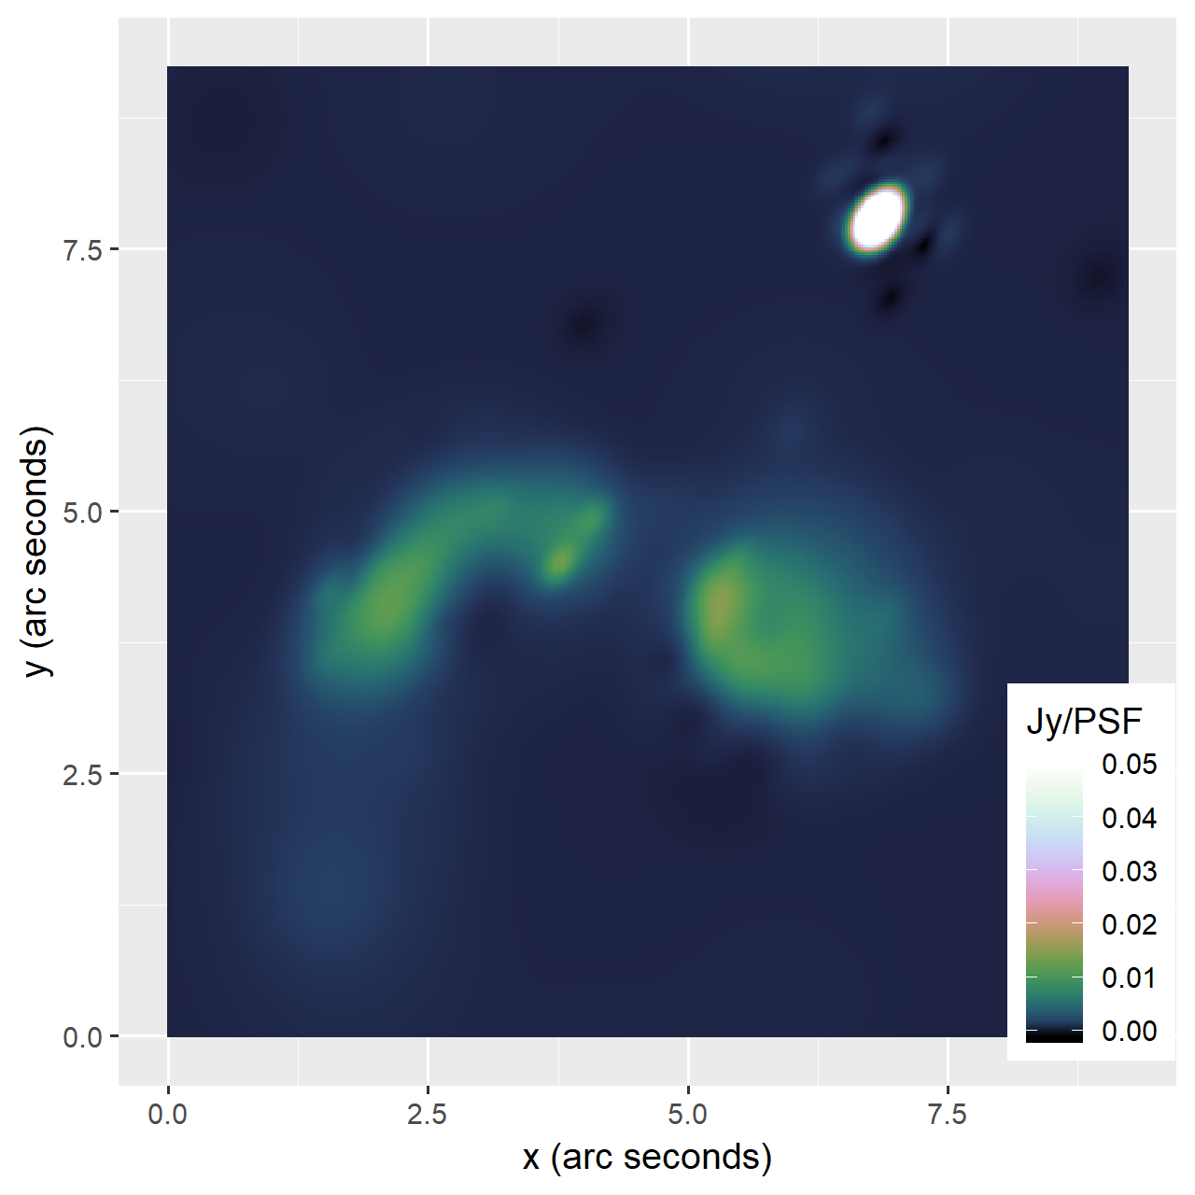
MS-CLEAN
Coordinate Descent
MS-CLEAN Briggs restored

